Slide 1
Topic: Geometry
EQ: How do I create logos and draw solids?
EST content

Slide 2
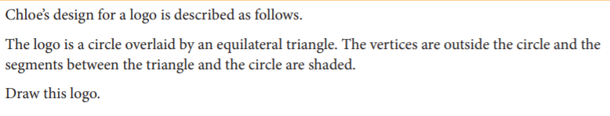
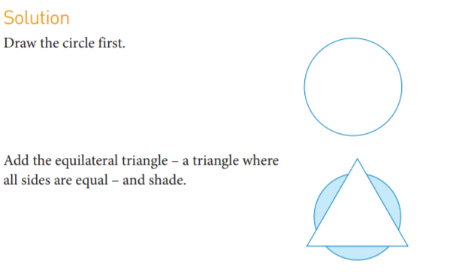
Example 1

Slide 3

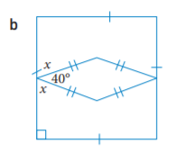
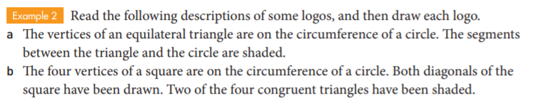
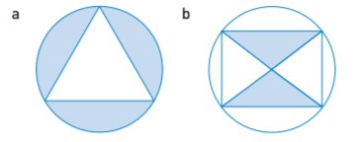
Practice
2.
Ans:

Slide 4
Drawing Solids Practice worksheet
Need isometric paper
Ruler

Slide 5
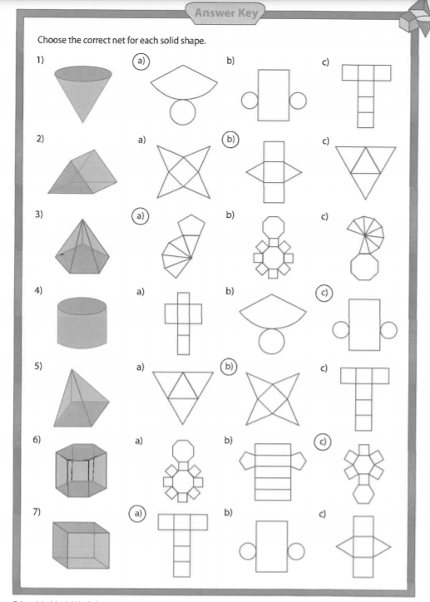
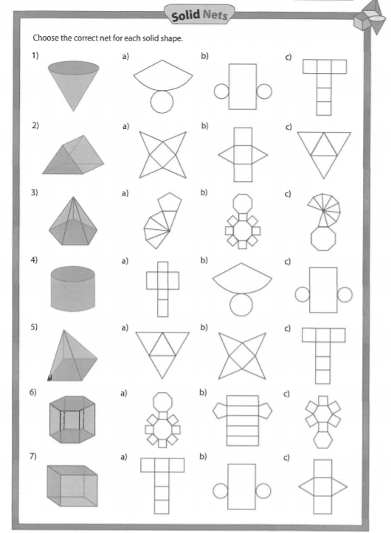
Nets worksheet

